Slide 1
COMP6049 – Algorithm Design and Analysis
Topic 24 – Strongly Connected Components

Slide 2
Outline Materials
Definition of Connected Components
Revisit DFS/BFS to find connected components
Definition of Strongly Connected Components
Tarjan’s Strongly Connected Components Algorithm

Slide 3
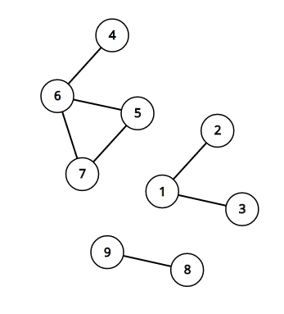
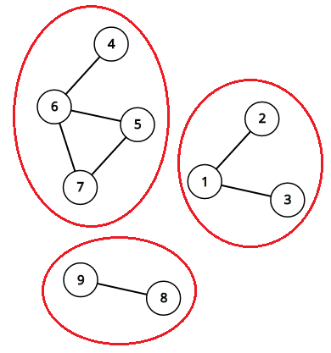
Connected Components
An undirected graph can be partitioned into several connected components
A connected component is a maximal subset of the vertices such that each pair of vertices is reachable from each other
An undirected graph with 3 connected components
An undirected graph with 3 connected components

Slide 4
Connected Components
We can find these components using depth-first search / breadth-first search
Pick some vertex that we don’t know anything about, and do a depth-first or bread-first search out from it.
All vertices that can be reached from that starting vertex are belong to the same component
Repeat this process for the remaining unvisited vertices until all vertices are visited and you will have all the components from that graph.
Time complexity is O( V+E ), where V is the number of vertices and E is the number of edges.

Slide 5
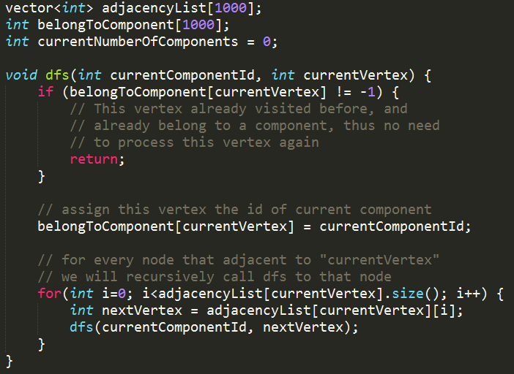
Connected Components

Slide 6
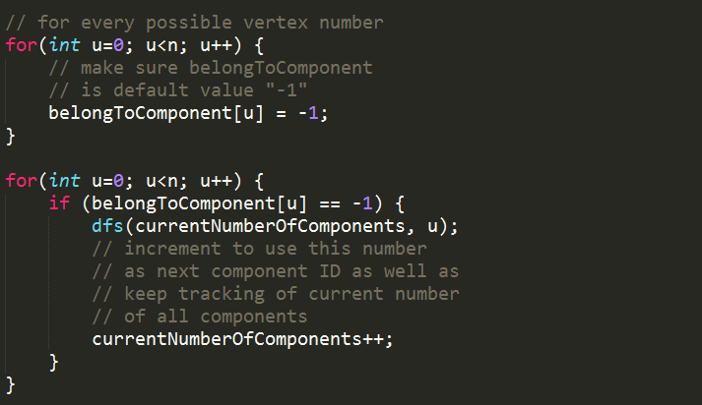
Connected Components

Slide 7
Strongly Connected Components
We know how to find connected components in undirected graphs
How about directed graph?
Components behave differently in directed graphs. Because if v can be reached by u, it doesn’t mean that u can be reached by v.
The definition of “Strongly Connected Components” is the same as “Connected Components” for undirected graph.
A strongly connected component is a maximal subset of the vertices such that each pair of the vertices in that component is reachable from each other.
The connected component algorithm (normal dfs-like) won’t work for this problem.

Slide 8
Tarjan’s SCC Algorithm
Published in 1972 by Robert Tarjan
Performs a single pass of depth-first search.
It maintains a stack of vertices that have been explored by the depth-first search but not yet assigned to a component.
It calculates “low numbers” of each vertex which it uses to determine when a set of vertices should be popped off the stack to a new component
“low numbers” is an index number of the highest ancestor reachable in one step from a descendant of the vertex

Slide 9
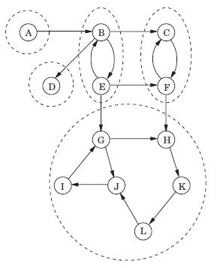
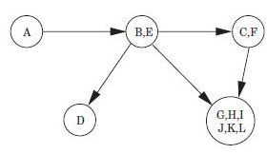
Tarjan’s SCC Algorithm
A directed graph with its Strongly Connected Component
The meta graph that shows we can “shrink” some nodes to just a node

Slide 10
Tarjan’s SCC Algorithm
This is a gif image

Slide 11
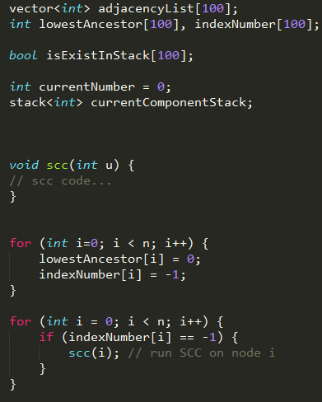
Tarjan’s SCC Algorithm

Slide 12
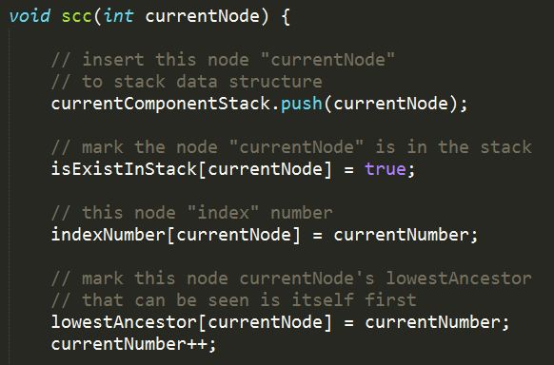
Tarjan’s SCC Algorithm

Slide 13
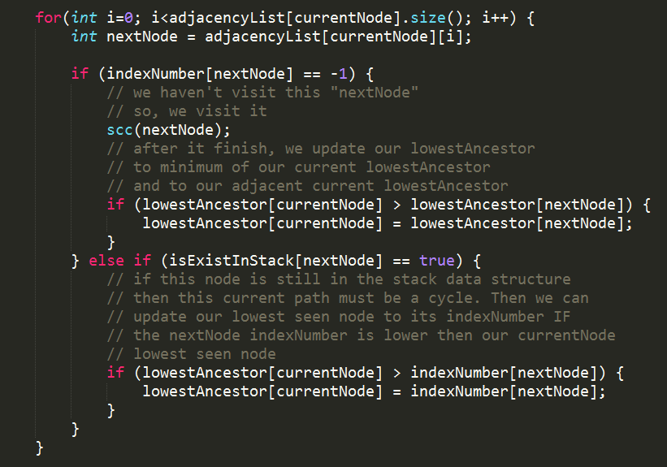
Tarjan’s SCC Algorithm

Slide 14
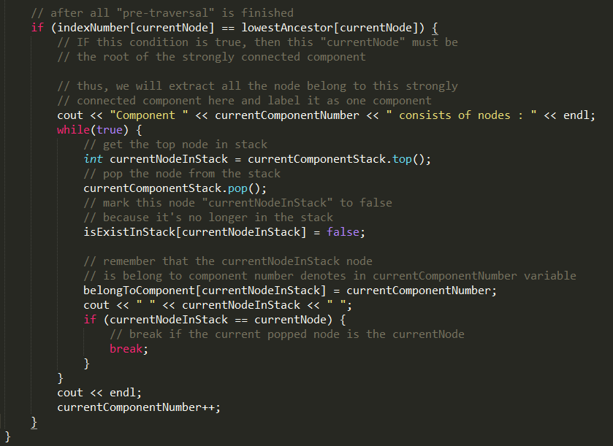
Tarjan’s SCC Algorithm

Slide 15
Tarjan’s SCC Algorithm
The above code assumes that the adjacency list has been filled.

Slide 16
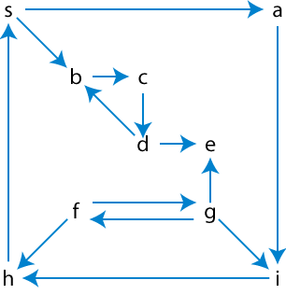
EXERCISE
Find the Strongly Connected Components usingTarjan’s SCC Algorithm

Slide 17
Q & A

Slide 18
References
Thomas H. Cormen. 2009. Introduction to algorithms. TMP. London. ISBN:9780262033848. Chapter 22
Strongly Connected Components Algorithm http://visualgo.net/en/dfsbfs
Graphs – Unweighted Graphs https://algo.is/aflv16/aflv_07_graphs_1.pdf

Slide 19
THANK YOU

